Slide 1
Living Standards Across Time and Space
Rajiv Sethi and the CORE Team
September 15, 2021

Slide 2
Preliminaries
Readings and Office Hours:
Textbook: The Economy
Supplementary Readings: CORE Insights
Office Hours: By appointment
Data Sources:
Our World in Data
Federal Reserve Economic Data
Google Finance

Slide 3
Overview
The State of the Economy
The Measurement of Production
Economic Growth
History’s Hockey Sticks
Technological Progress
Environmental Impacts
Inequality Across Space and Time
Reading: The Economy Units 1.1 to 1.5

Slide 4
Measuring Production
Main measure is Gross Domestic Product (GDP)
Value of total goods/services produced over given period of time
When divided by the population: GDP per capita
When valued at the prices at which they are sold: Nominal GDP
If one year’s prices are used to value output in all years: Real GDP
The year whose prices are used to compute Real GDP: base year
Nominal GDP grows when more is produced and/or prices rise
Real GDP only grows when actual production grows

Slide 5
History’s Hockey Sticks
Real GDP per capita in most of the world was flat for centuries
Then, starting in Britain around 1700, rapid and sustained growth
In Japan, growth starts to take off around 1870
In China and India, latter part of the 20th century
Graphs reveal a sequence of hockey sticks
With wide variation across countries in rates of growth

Slide 6
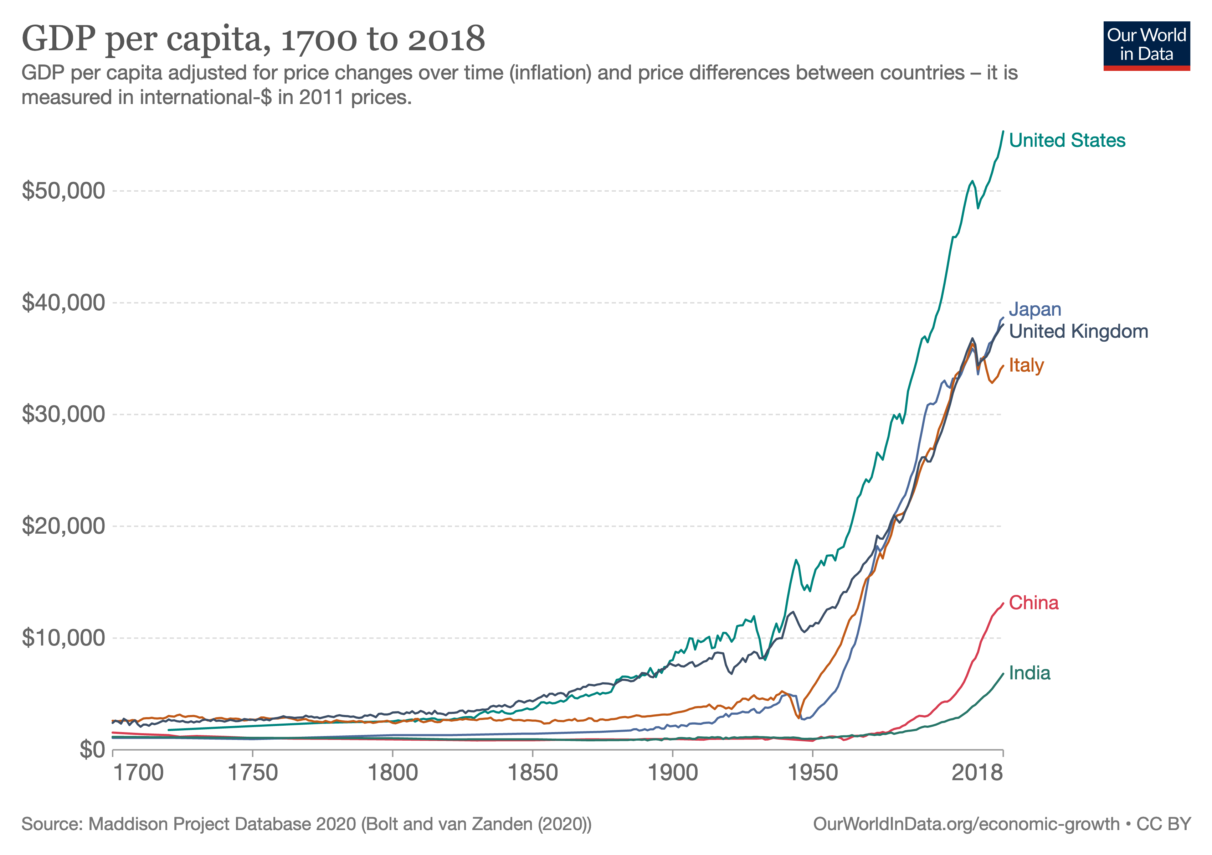
View Latest Data

Slide 7
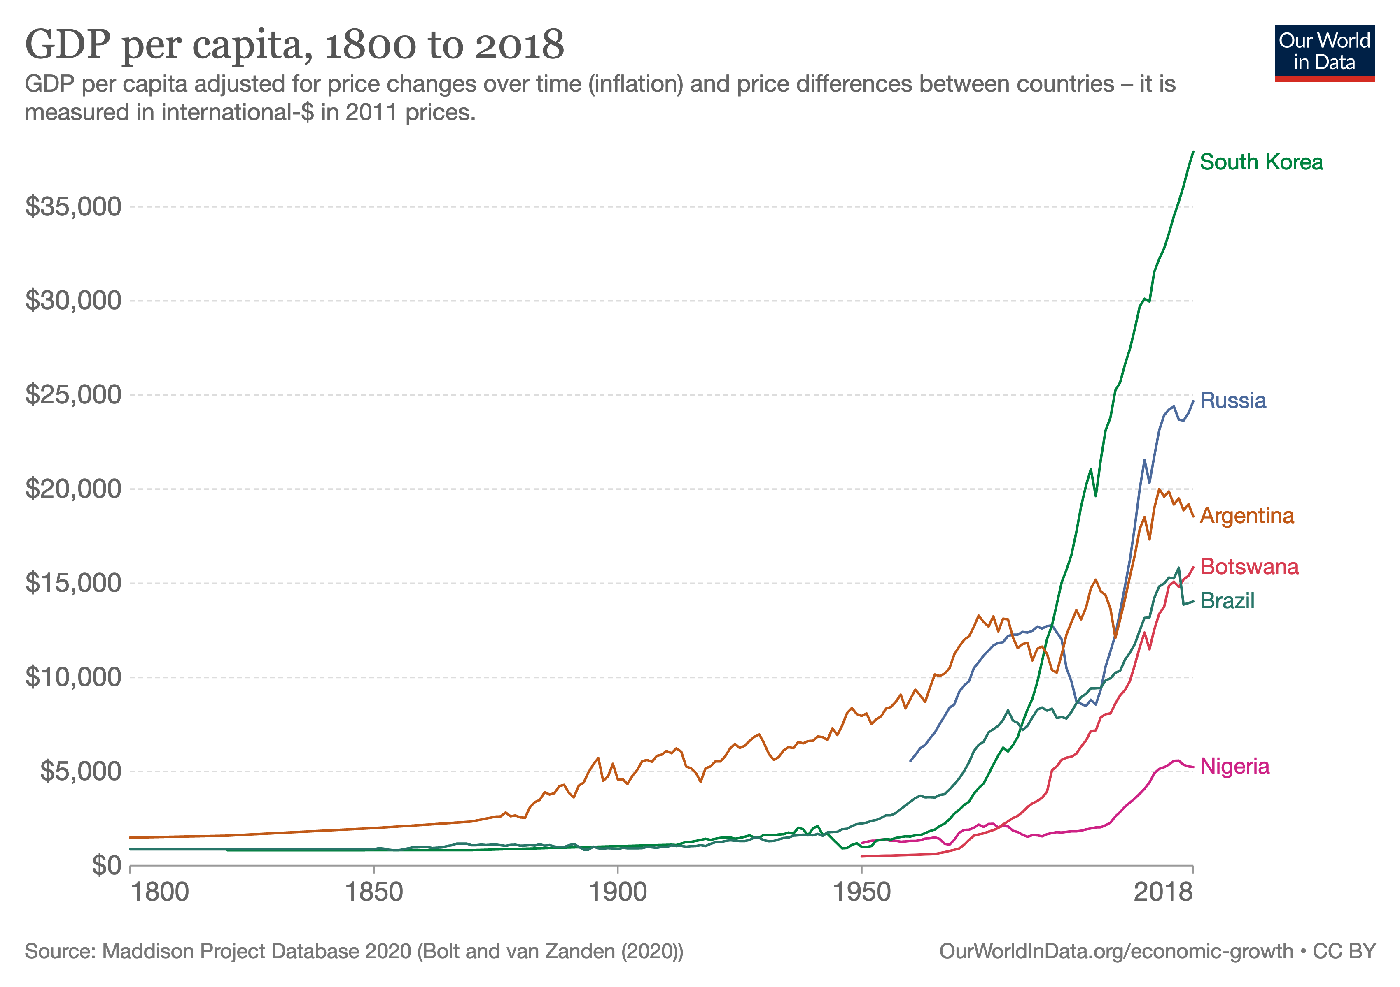
View Latest Data

Slide 8
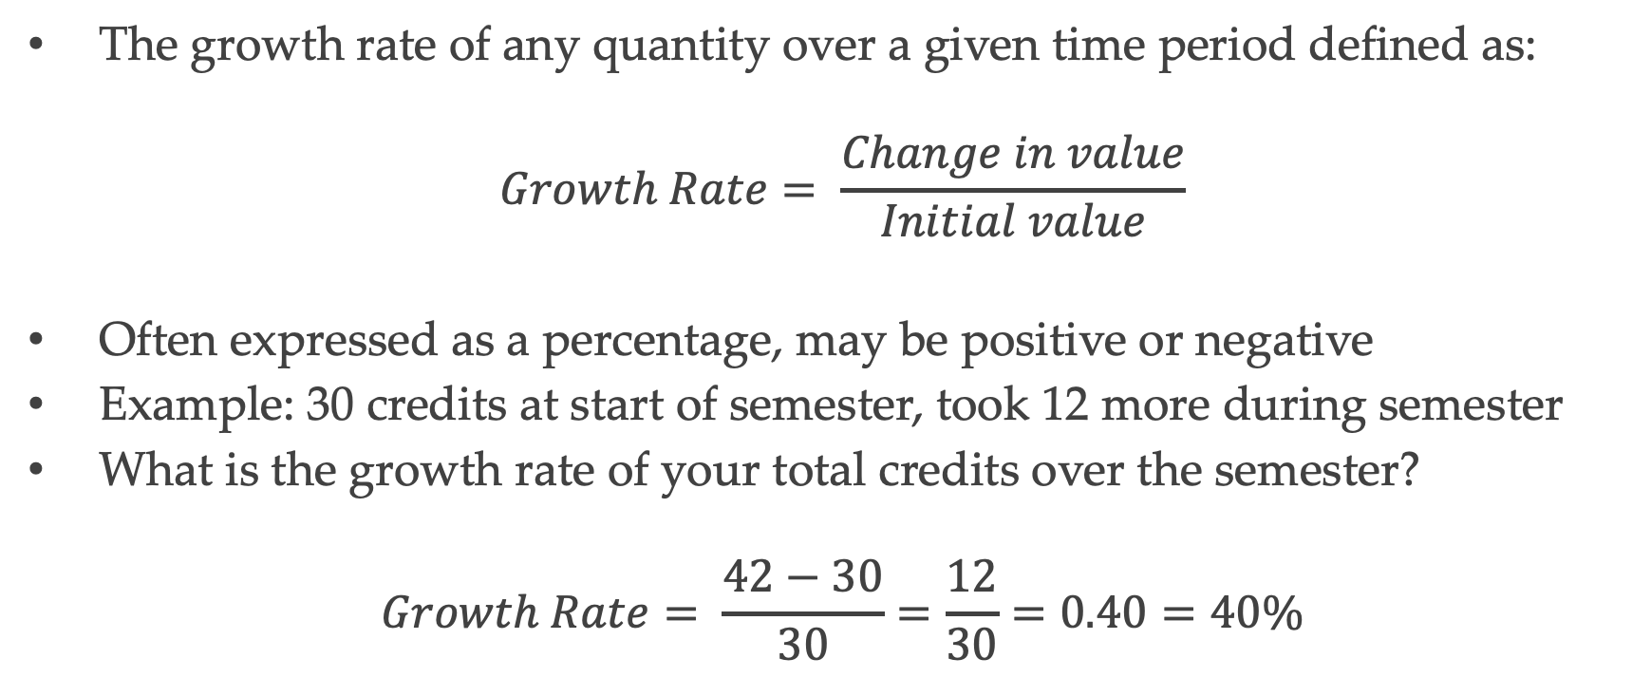
Measuring Growth
The growth rate of any quantity over a given time period defined as:
$$Growth Rate= \frac{Change in value}{Initial value}$$
Often expressed as a percentage, may be positive or negative
Example: 30 credits at start of semester, took 12 more during semester
What is the growth rate of your total credits over the semester?
$$Growth Rate= \frac{42−30}{30}=\frac{12}{30}=0.40=40\%$$

Slide 9
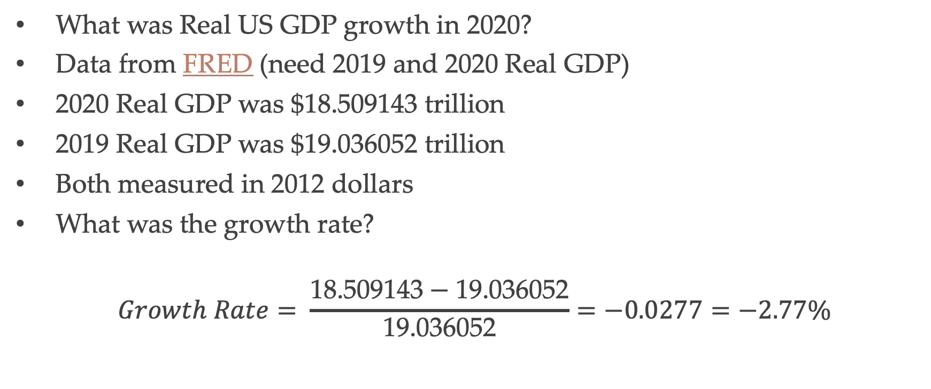
Measuring Growth of GDP
What was Real US GDP growth in 2020?
Data from FRED (need 2019 and 2020 Real GDP)
2020 Real GDP was $18.$\text{509143}$ trillion
2019 Real GDP was $19.036052 trillion
Both measured in 2012 dollars
What was the growth rate?
$$Growth Rate= \frac{\text{18.}\text{509143}−\text{19.036052}}{\text{19.036052}}=−0.0277=−2.77\%$$

Slide 10
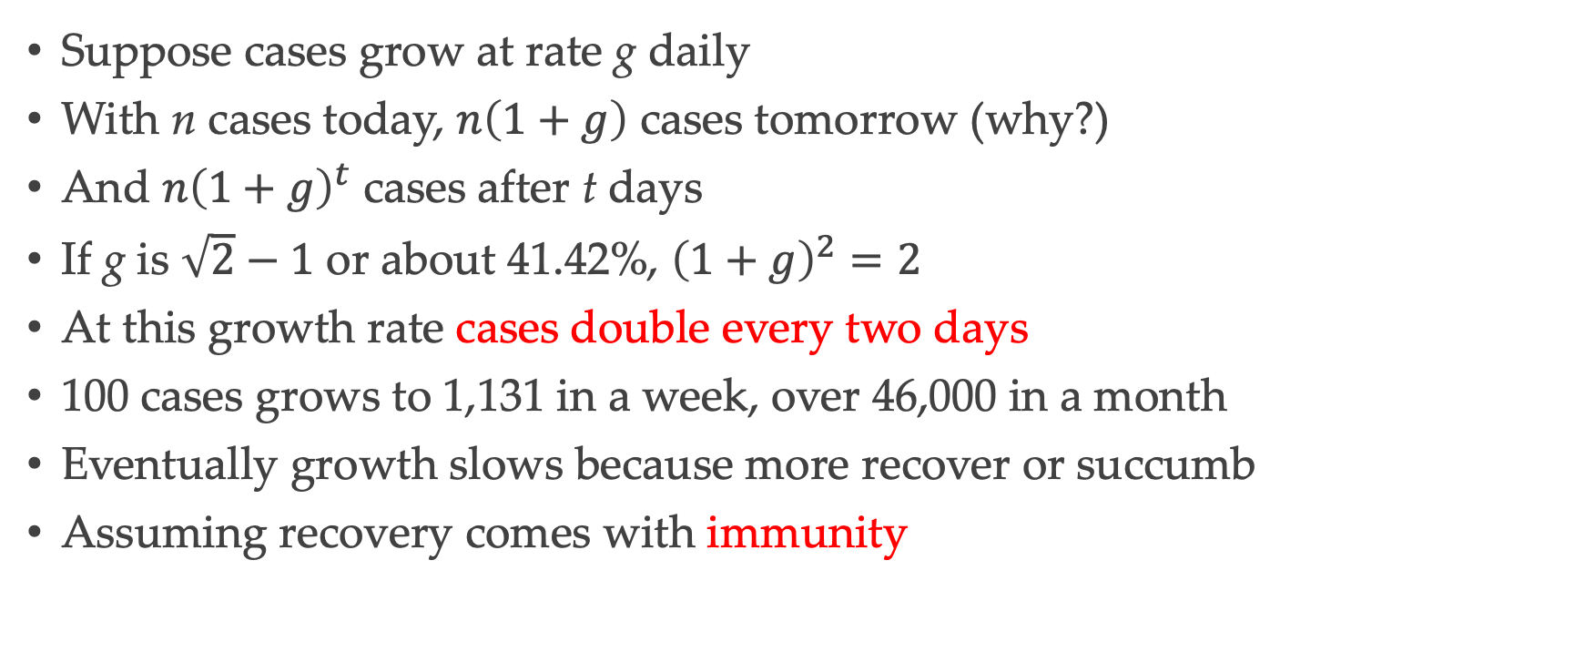
COVID-19 Growth Rates
Suppose cases grow at rate g daily
With n cases today, $n\left(1+g\right)$ cases tomorrow (why?)
And $n{\left(1+g\right)}^{t}$ cases after t days
If g is $\sqrt{2}−1$ or about 41.42%, ${\left(1+g\right)}^{2}=2$
At this growth rate cases double every two days
100 cases grows to 1,131 in a week, over 46,000 in a month
Eventually growth slows because more recover or succumb
Assuming recovery comes with immunity

Slide 11
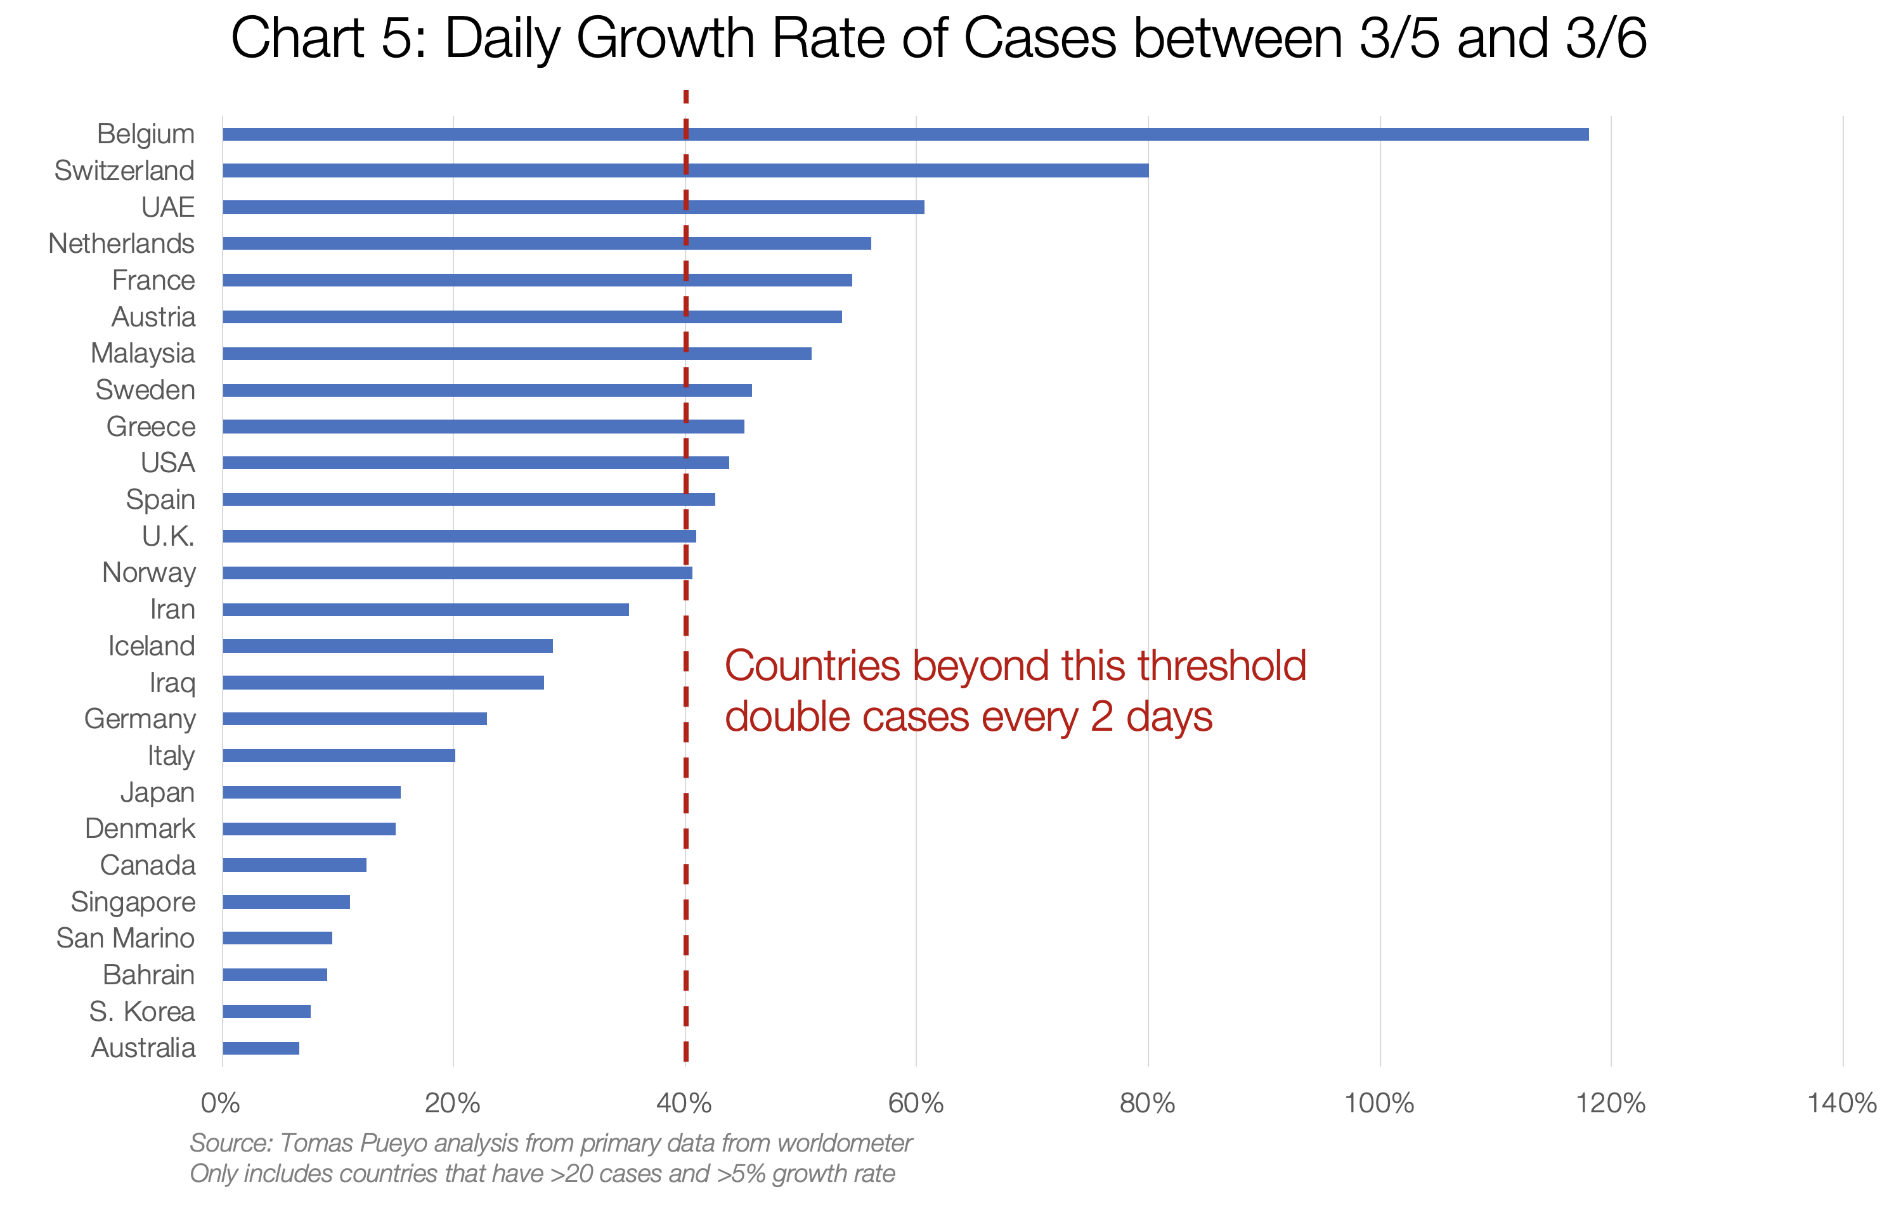

Slide 12
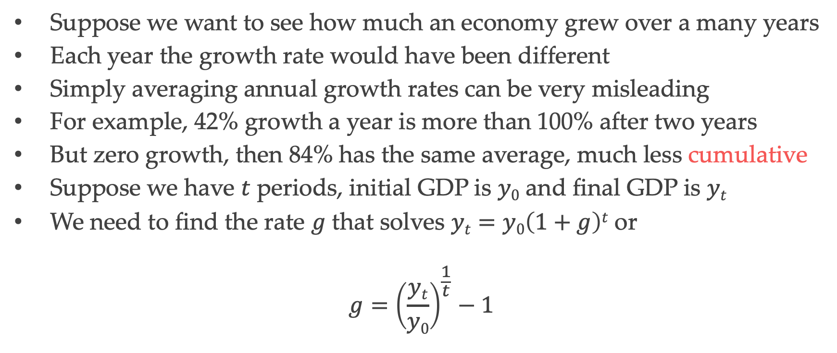
Compound Growth Rates
Suppose we want to see how much an economy grew over a many years
Each year the growth rate would have been different
Simply averaging annual growth rates can be very misleading
For example, 42% growth a year is more than 100% after two years
But zero growth, then 84% has the same average, much less cumulative
Suppose we have $t$ periods, initial GDP is $y0$ and final GDP is $yt$
We need to find the rate $g$ that solves $yt=y0\left(1+g\right)t$ or
$$g={\left(\frac{yt}{y0}\right)}^{\frac{1}{t}}−1$$

Slide 13
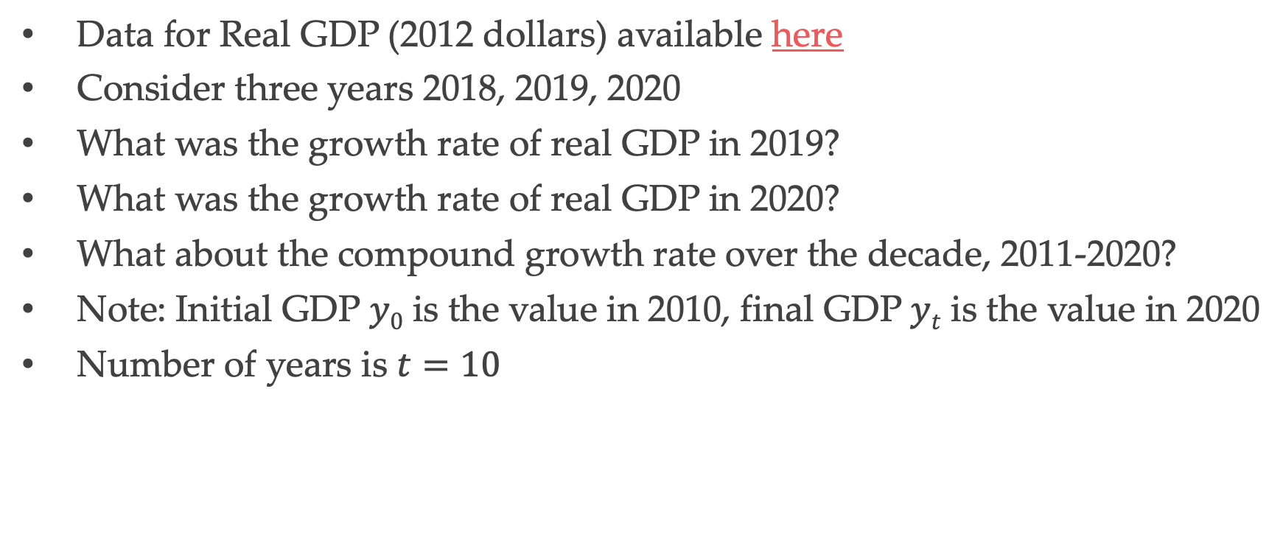
Working with Data
Data for Real GDP (2012 dollars) available here
Consider three years 2018, 2019, 2020
What was the growth rate of real GDP in 2019?
What was the growth rate of real GDP in 2020?
What about the compound growth rate over the decade, 2011-2020?
Note: Initial GDP $y0$ is the value in 2010, final GDP $yt$ is the value in 2020
Number of years is $t=10$

Slide 14
Technology
A technology is a process that uses resources (inputs) to produce outputs
Progress occurs when output can be produced with fewer resources
Also involves the production of new kinds of goods and services
Scientific advances facilitate technological progress
This allows an increase in living standards
Example 1: productivity of labor in producing light
Example 2: increased speed with which information travels

Slide 15
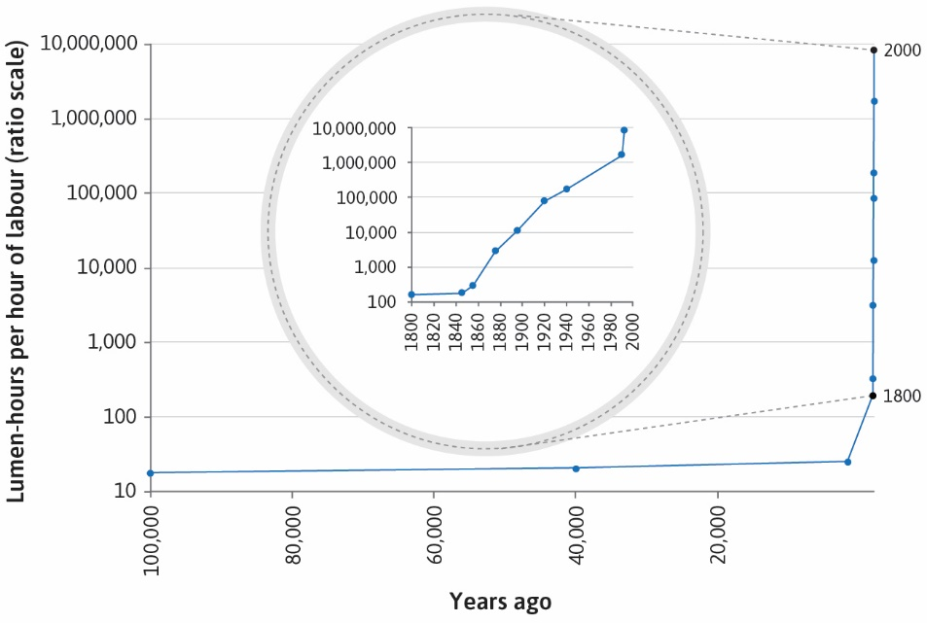

Slide 16
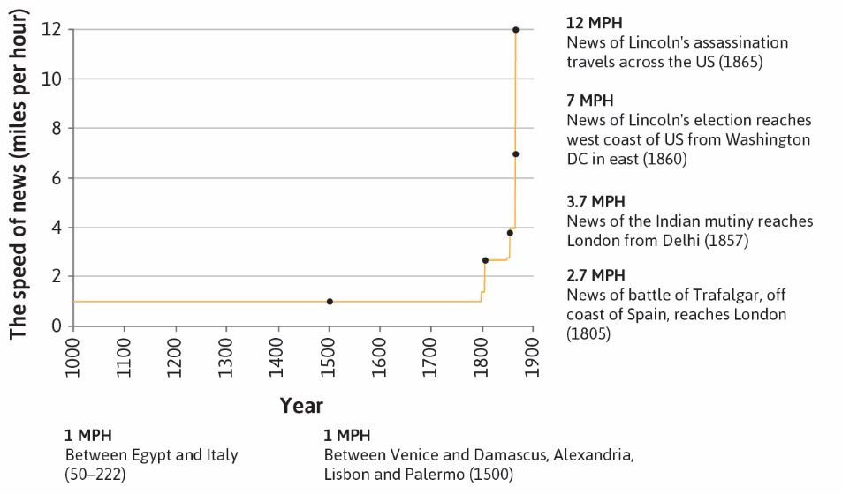

Slide 17
Environment
With rapid growth comes environmental impact
Example: Fossil fuel combustion has local, regional, global effects
Local effects: greater air pollution, breathing disorders
Regional effects: acid rain affects agriculture and marine life in lakes
Global effects: greater carbon concentration, climate change

Slide 18
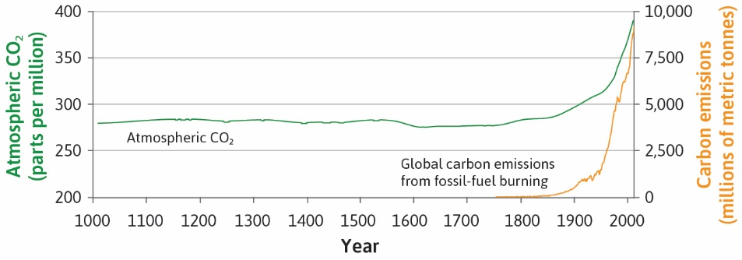

Slide 19
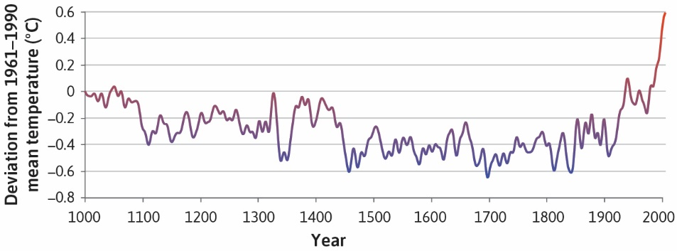

Slide 20
Measuring Inequality
GDP per capita just tells us about average income in a country
This may be very unequally distributed
A simple way to measure inequality: average income within deciles
Top 10%, next 10%, … bottom 10%
In 2014 Singapore had highest average income, Liberia lowest
Top decile in Singapore had $67,436, bottom decile $3,652
Top decile in Liberia had $994, bottom decile $17
Average income and inequality can be seen in skyscraper graphs

Slide 21
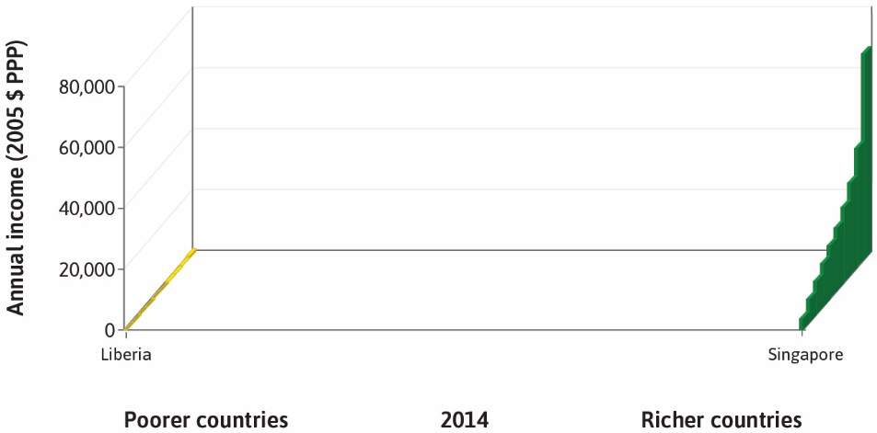

Slide 22
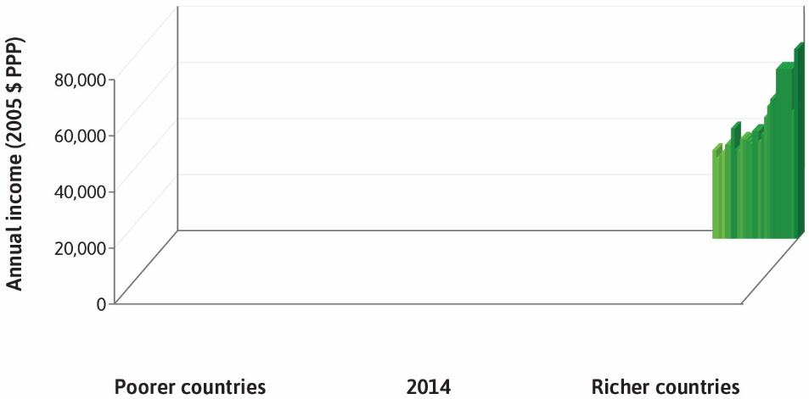

Slide 23
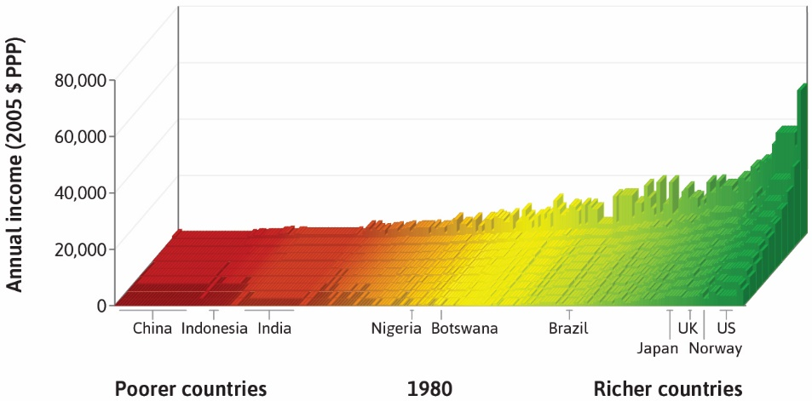

Slide 24
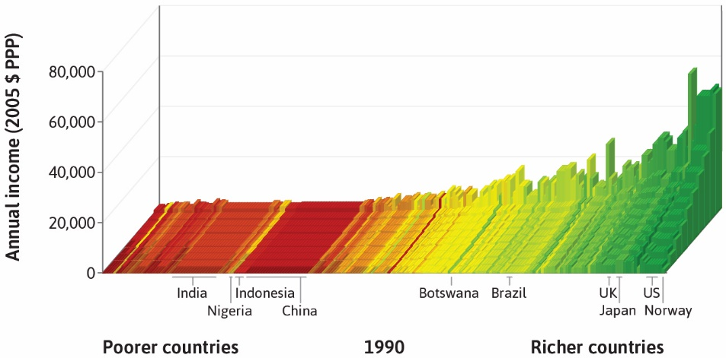

Slide 25
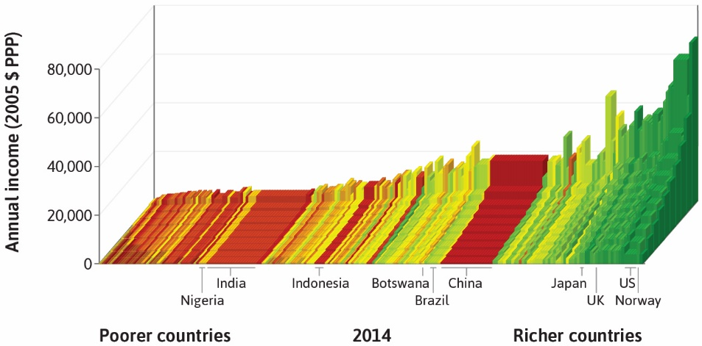

Slide 26
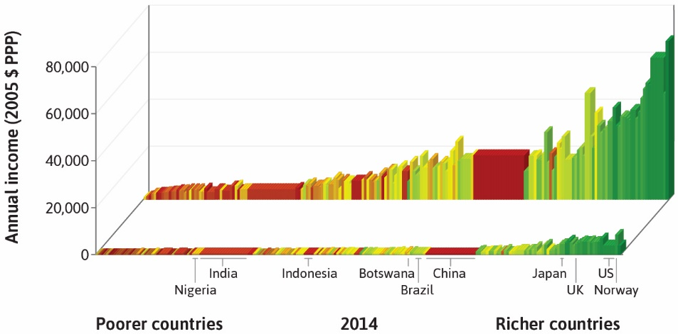

Slide 27
Working with Data
Data for skyscraper graph is available here
Consider United States in 1980 and 2014
What is the ratio of top to bottom decile mean income in these years?
Has inequality increased or decreased?
By what percentage has the ratio changed over this period?
Over which period did inequality change most rapidly?
Other inequality measures (Lorenz curve, Gini coefficient) later in course

